Slide 1
CMP_SC 3380 Final project Group 18
Reconstruction of the Student Unions website.

Slide 2
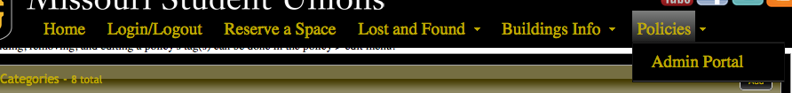
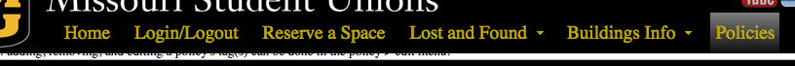
PHP5
JQuery
JQuery UI
Custom JQuery UI Theme
Custom Menu
“Scroll then Sticky”
Animations
Ability to hide
or show based on admin status

Slide 3
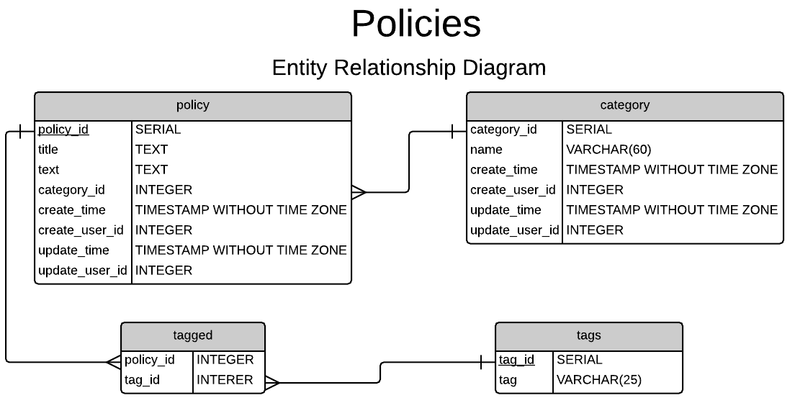

Slide 4
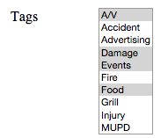
Adding/removing tag(s) from policies.
foreach (item in new_array) {
check if not in old_array
}
foreach (item in old_array) {
check if not in new_array
}
INSERT item INTO tag table
DELETE item FROM tag table
new_array
old_array

Slide 5
Lost and Found (starting out):
LDAP credential connections for Mizzou students and administrators
Admin approval for item types (Picture???)
Secure entry of information by users to keep from injection attacks and issues
Tables are cross referenced, to keep all information most updated and current
Sessions are passed to allow other parts of the website to access the same LDAP connection

